Slide 1
Lesson objective
Need whiteboards
PBiS focus: Respect
Build positive relationships
Treat others with kindness
Title: Percentages
Aim – be able to:
Determine 1%, 5% and 10% of amounts
Divide and multiply by powers of 10 using written strategies
Plan:
Review FDP conversions
Finding percent's

Slide 2
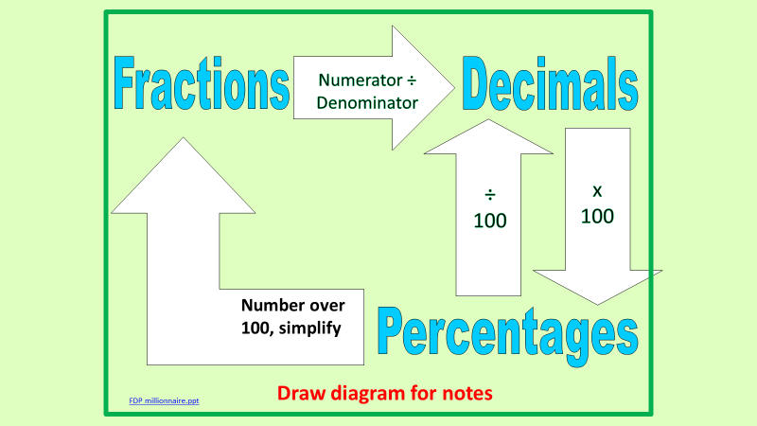
Daily review
Retrieve
Fraction
5/20
Decimal
0.25
0.31
Percent
45%
31%

Slide 3
Moving decimals
https://www.youtube.com/watch?v=VwjTUTUB2xw

Slide 4
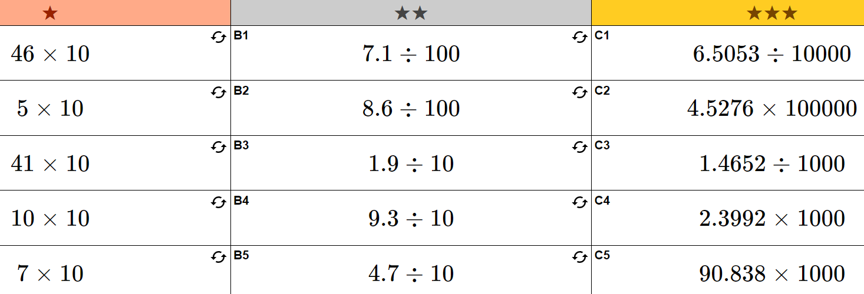
Exercise books – 5 minutes

Slide 5
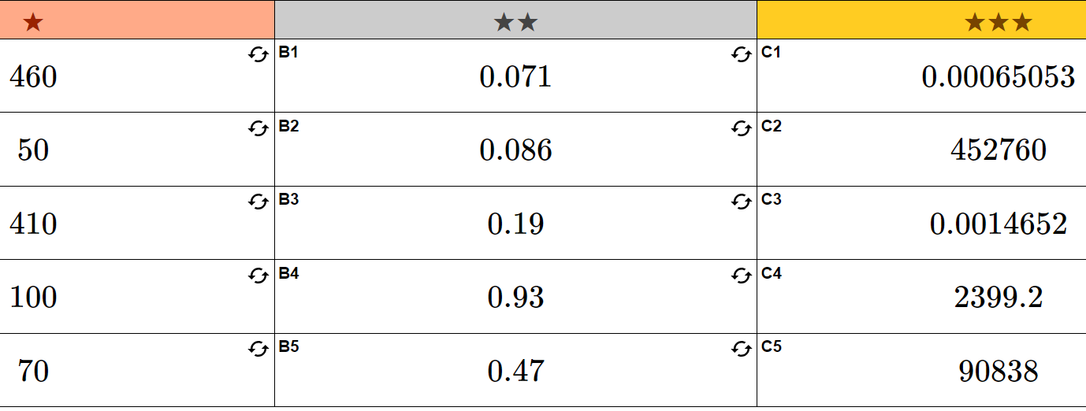
Answers

Slide 6
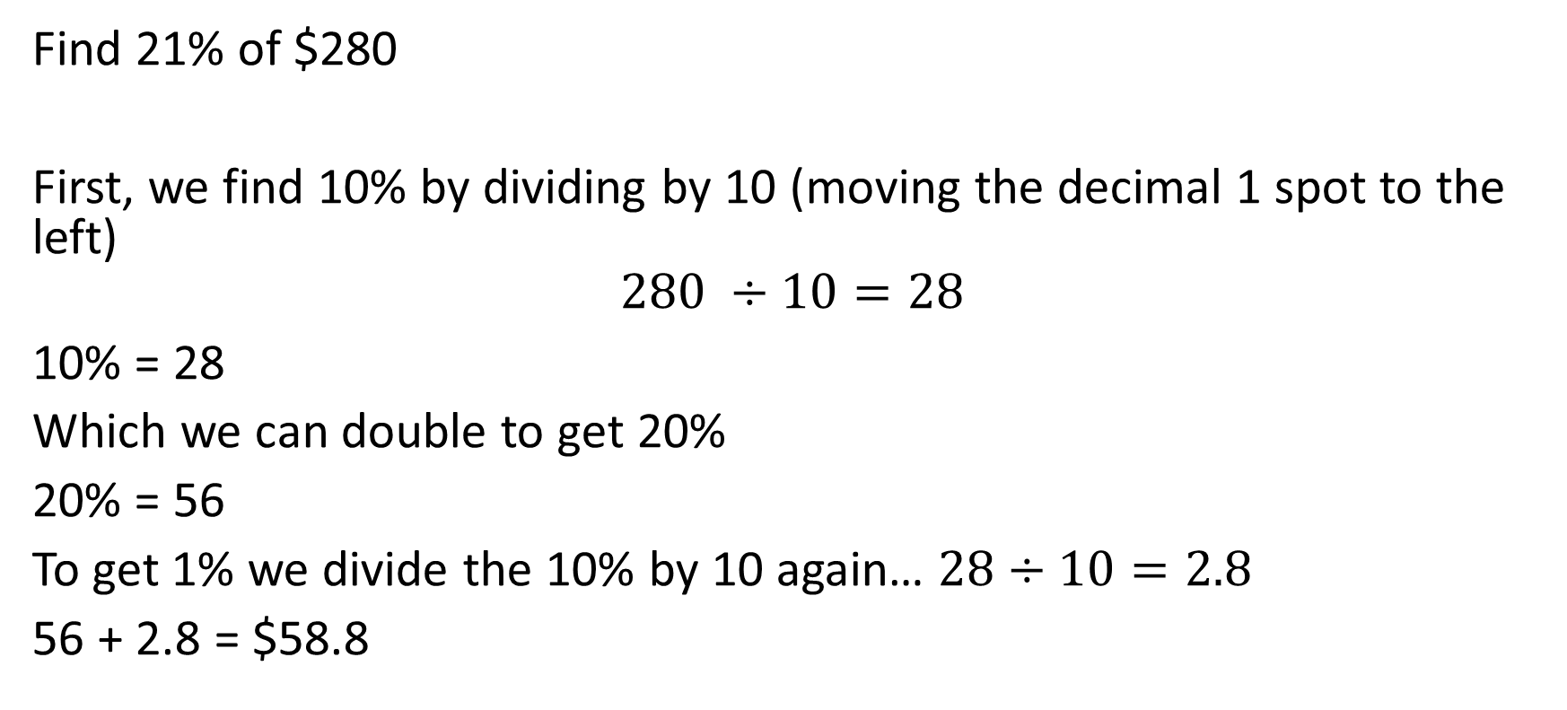
Percent of an amount
Find 21% of $280
First, we find 10% by dividing by 10 (moving the decimal 1 spot to the left)
$$280 ÷10=28$$
10% = 28
Which we can double to get 20%
20% = 56
To get 1% we divide the 10% by 10 again… $28÷10=2.8$
56 + 2.8 = $58.8

Slide 7
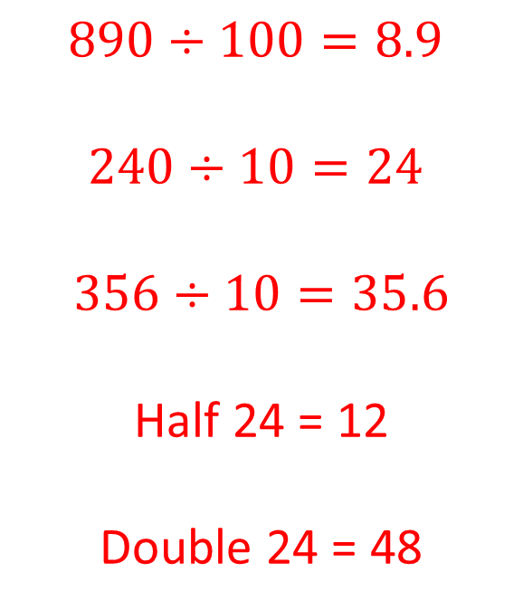
Examples
$$890÷100=8.9$$
$$240÷10=24$$
$$356÷10=35.6$$
Half 24 = 12
Double 24 = 48
1% of 890
10% of 240
10% of 356
5% of 240
(find 10% then half it)
20% of 240
(find 10% and double it)

Slide 8
Whiteboards
Find 10%, 5% and 1% of the following amounts
$80
120g
1500L
10% =
5% =
1% =
12
150
8
Find 85% of 160
4
6
75
136
0.8
1.2
15

Slide 9
Individual practice – Page 190
Not confident?
Confident?
Questions 1 – 12.
Start at question 5 go to 12.

